Slide 1
Sudoku Part 3
The SudokuBoard Class

Slide 2
We need an object that…
Represents a 9x9 Sudoku board
Can create it’s 9x9 Sudoku board
Can get a cell at a specified row, column
Can clear it’s 9x9 Sudoku board (reset each cell)
Can find a set of all possible numbers for a cell
Can check to see if it’s board is valid
Can solve it’s 9x9 board

Slide 3
Creating the object
Right click on your ‘Solver’ Python package and click New -> Python File
Name the new Python File SudokuBoard
Copy and paste the code from https://github.com/dlowrey/SudokuSolver/blob/master/Templates/temp_sudokuboard.py
You now have a SudokuBoard object with the template for all of the methods we need!

Slide 4
Initializing a self.game_board variable
We need to initialize a variable that is a 9x9 matrix of Cells.
Can you think of some ways to do this?
Remember, a matrix is just a list of lists, i.e. [[], [], [], []]
We need to iterate through and visit each row, column in the matrix and put a cell in it.

Slide 5
Self.game_board initializing algorithm
For each row in the range(9)
For each column in the range(9)
Create a new cell object at [row][column]
Write the code that follows the algorithm to initialize your 9x9 board with 81 cells!

Slide 6
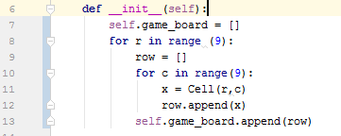
Initializing the self.game_board

Slide 7
A handy algorithm…
For row in range(9)
For column in range(9)
do something to the cell
THIS will be in our algorithms used for modifying the board over and over again, so remember it! This algorithm will allow you to touch every single cell on the 9x9 board!

Slide 8

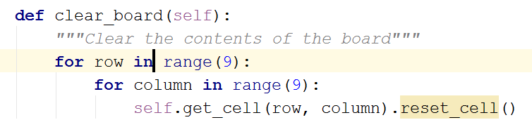
More Methods!
Write the body of the get_cell method in your SudokuBoard class!
Now write the body of the clear_board method in your SudokuBoard class! (Remember the handy algorithm we talked about!)

Slide 9
The GUI
Now we will implement a Graphical User Interface for your Sudoku Board.
We will use the GUI to interact with our self.game_board variable, as well as test the other methods we write later
The GUI was made using a 3rd part module called Tkinter. I mostly followed the examples found in this tutorial (http://newcoder.io/gui/part-3/)
Right click on your ‘Solver’ python package and click New->Python File
Name the new file GUI
Copy/Paste the code from https://github.com/dlowrey/SudokuSolver/blob/master/Solver/GUI.py

Slide 10
The run.py file
We now need a file that will bring all of our objects together with the GUI and use them to display the GUI on screen.
Right click on your ‘Solver’ python package and click New -> Python File
Name the new file run
Copy/Paste the code from https://github.com/dlowrey/SudokuSolver/blob/master/Solver/run.py
(We are doing a lot of copy/paste on the code that doesn’t really pertain to actually solving the Sudoku board, but is more of helper code. You can review and see exactly how it all works if you would like)

Slide 11
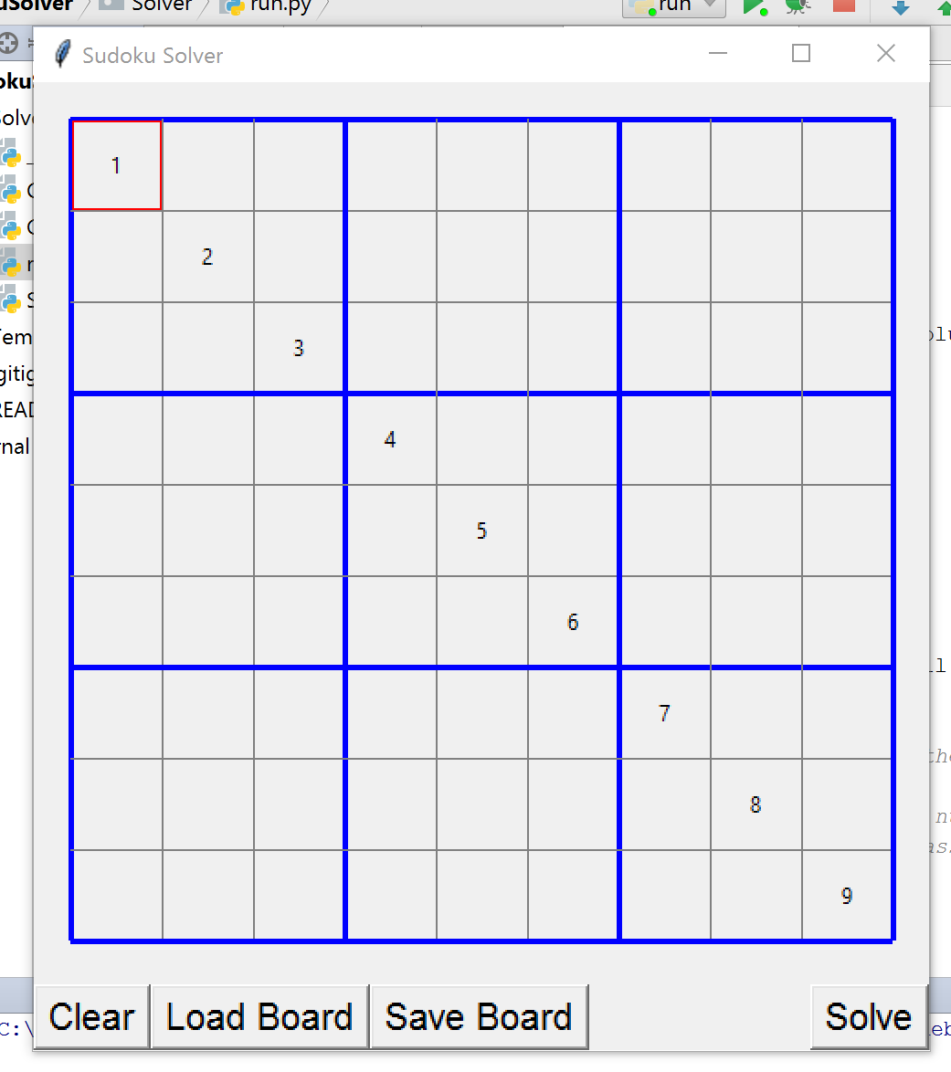
Run the program
You can now right click and run the ‘run.py’ file if you do not have any errors. It should bring up a blank Sudoku Board GUI. You can click in the cells and type in numbers, and navigate the cells with your arrow keys.
The only Button that works as of now is the ‘Clear’ button, which uses the method you just wrote to clear the game board.

